Slide 1
Artificial intelligence and machine learning
Session no: 1.2
Topic: INTELLIGENT AGENTS

Slide 2
Intelligent Agent
Agent: element in a system or environment that can trigger action.
agent refers to an autonomous entity that perceives its environment through sensors and acts upon that environment through actuators, inorder to achieve specific goals or objectives.
The perception capability is usually called a sensor.

Slide 3
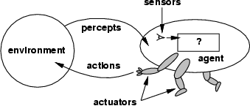
Agents
An agent is anything that can be viewed as
perceiving its environment through sensors and
acting upon that environment through actuators
Assumption: Every agent can perceive its own actions (but not always the effects)

Slide 4
Agents cont’d
Human agent:
Eyes, ears, and other organs for sensors;
Hands, legs, mouth, and other body parts for actuators
Robotic agent:
cameras and infrared range finders for sensors;
various motors for actuators
A software agent:
Keystrokes, file contents, received network packages as sensors
Displays on the screen, files, sent network packets as actuators

Slide 5
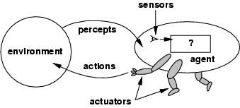
Agent function
A mathematical formula called the agent function converts a series of observations into actions.
The function is implemented as the agent program.
Actuator refers to the component of an agent that performs an action.
environment → sensors → agent function → actuators → environment

Slide 6

Environment
Environment
Sensors
Percept (Observations)
Agent Function
Agent
Actuator
Environment
Action
Environment

Slide 7
Rational agent
A rational agent is one who can make the best choice in any circumstance.
A set of standards or testing ground for an agent's behaviour that serves as a performance measure.
Based on the agent's intended impact on the environment, performance metrics should be developed.

Slide 8
Agents and environments
Percept sequence: complete history of everything the agent has ever Perceived
Percept: agent’s perceptual input at any given instant
An agent’s choice of action at any given instant can depend on the entire percept sequence observed to date
An agent’s behavior is described by the agent function which maps from percept histories to actions:
f:P∗→A
We can imagine tabulating the agent function that describes any given agent (External characterization)
Internally, the agent function will be implemented by an agent program which runs on the physical architecture to produce f
agent = architecture + program

Slide 9
Agent types
Four basic types in order of increasing generality:
Simple reflex agents: These agents take actions based solely on the current percept (sensory input). They do not maintain any internal state or memory.
Model-based reflex agents: These agents maintain an internal state or model of the world and use it to make decisions.
They consider past perceptions and actions to make more informed decisions.

Slide 10
CONT.....
Goal-Based Agents: These agents operate by considering their goals or objectives.
They plan and execute actions that are expected to lead to the achievement of those goals.
Utility-Based Agents: These agents evaluate actions based on a utility function or a measure of desirability.
They choose actions that maximize expected utility, which may involve trade-offs between conflicting goals.

Slide 11
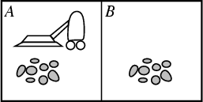
Example: vacuum-agent
Percepts:
Location and status, e.g., [A,Dirty]
Actions:
Left, Right, Suck.
function Vacuum-Agent([location, status]) returns an action
if status = Dirty then return Suck
else if location = A then return Right
else if location = B then return Left

Slide 12
Vacuum cleaner agent
The vacuum cleaner agent perceives its environment through sensors that detect the cleanliness of the squares (or locations) in a grid-world environment. Each square can either be clean or dirty.
Actions:The actions available to the vacuum cleaner agent typically include:
Suck: Clean the current square.
Move: Move to an adjacent square (up, down, left, right).
Environment: The environment is represented as a grid where each square can be in one of two states: clean or dirty. The agent's task is to clean all dirty squares.

Slide 13
CONT.....
State Representation:The state of the environment and the agent is represented by the location of the agent and the cleanliness status of each square in the grid.
Goal:
The goal of the vacuum cleaner agent is to clean all dirty squares in the grid-world environment.

Slide 14
Vacuum cleaner agent
Same agent would be irrational under different circumstances
Once all dirt is cleaned up it will oscillate needlessly back and forth.
If the performance measure includes a penalty of one point for each movement left or right, the agent will fare poorly.
A better agent for this case would do nothing once it is sure that all the squares are clean.
If the clean squares can become dirty again, the agent should occasionally check and clean them if needed.
If the geography of the environment is unknown the agent will need to explore it rather than stick to squares A and B

Slide 15
Simple reflex agents
Select actions on the basis of the current percept ignoring the rest of the percept history
Example: simple reflex vacuum cleaner agent
Condition-action-rule
Example: if car-in-front-is-breaking then initiate-breaking
function REFLEX-VACUUM-AGENT([location,status]) returns an action
if status = Dirty then return Suck
else if location = A then return Right
else if location = B then return Left

Slide 16
Simple reflex agents
Simple-reflex agents are simple, but they turn out to be of very limited intelligence
The agent will work only if the correct decision can be made on the basis of the current percept – that is only if the environment is fully observable
Infinite loops are often unavoidable – escape could be possible by randomizing

Slide 17
Model-based reflex agents
The agent should keep track of the part of the world it can't see now
The agent should maintain some sort of internal state that depends on the percept history and reflects atleast some of the unobserved aspects of the current state
Updating the internal state information as time goes by requires two kinds of knowledge to be encoded in the agent program
Information about how the world evolves independently of the agent
Information about how the agent's own actions affects the world
Model of the world – model based agents

Slide 18
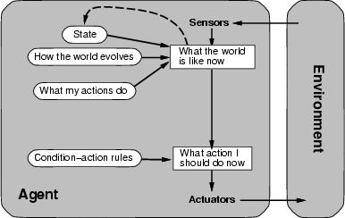
Model-based reflex agents

Slide 19
Goal-driven agents
The agent has a goal, and the action that will be taken will rely on both the current situation and the goal that the agent is attempting to achieve.
The objective is sometimes simple to reach. In other cases, it entails planning, searching through a search space for potential answers, and coming up with a strategy.
Utility-based agents: The utility function that calculates how near the current state is to the agent's goal is known to the agent.

Slide 20
Learning agents
Agents with the capacity to learn new skills through observations and acts.
Components:
Learning component (modifies the performance component)
aspect of performance (selects actions)
exploration element (problem generator) and
feedback element (critic).

Slide 21
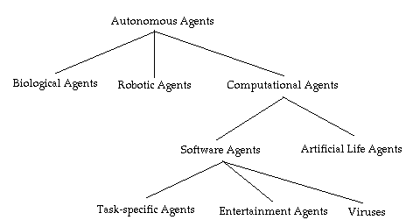
Agent classification

Slide 22
Turing test in Artificial Intelligence What is Intelligence?
Intelligence:
capacity to learn and solve problems”
(Webster dictionary)
the ability to act rationally
… Not so easy to define.

Slide 23
What is AI?
Views of AI fall into four different perspectives --- two dimensions:
1) Thinking versus Acting
2) Human versus Rational (which is “easier”?)
Human-like
Intelligence
“Ideal” Intelligent/
Pure Rationality
Which is
closest to
a ‘real’ human?
Thought/
Reasoning
2. Thinking humanly | 3. Thinking Rationally
1. Acting Humanly | 4. Acting Rationally
Behavior/
Actions
“behaviorism”
Furthest?

Slide 24
Different AI Perspectives 1. Acting Humanly
Human-like
Intelligence
“Ideal” Intelligent/
Rationally
2. Thinking humanly | 3. Thinking Rationally
1. Acting Humanly →Turing Test | 4. Acting Rationally
Thought/
Reasoning
Behavior/
Actions

Slide 25
2. Thinking human: modeling cognitive processes
Requires scientific theories of internal activities of the brain.
1) Cognitive Science (top-down) computer models + experimental techniques from psychology
→ Predicting and testing behavior of human subjects
2) Cognitive Neuroscience (bottom-up)
→ Direct identification from neurological data

Slide 26
Neuroscience: The Hardware
The brain
a neuron, or nerve cell, is the basic information
processing unit (10^11 )
many more synapses (10^14) connect the neurons
cycle time: 10^(-3) seconds (1 millisecond)
How complex can we make computers?
10^9 or more transistors per CPU
Ten of thousands of cores, 10^10 bits of RAM
cycle times: order of 10^(-9) seconds
Numbers are getting close! Hardware will surpass human brain within next 20 yrs.

Slide 27
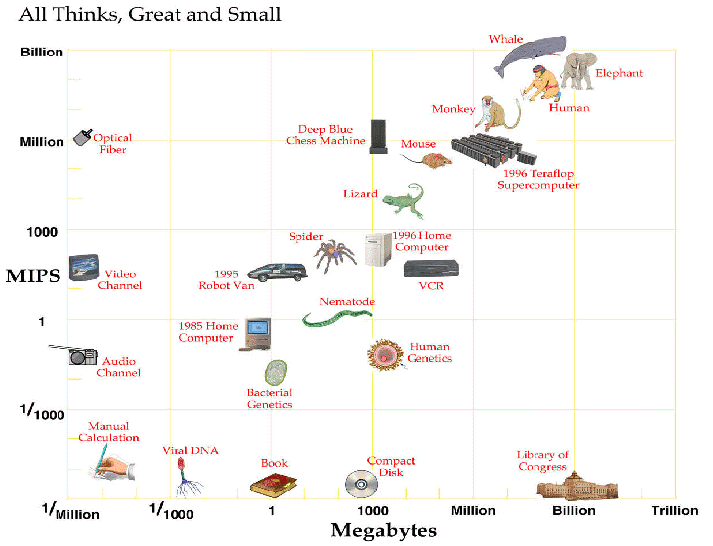
Computer vs Brain
approx. 2025
Current:
Nvidia: tesla
personal super-
computer
1000 cores
4 teraflop
Aside: Whale vs. human brain

Slide 28
4. Acting Rationally Rational agents
An agent is an entity that perceives and acts in
the world (i.e. an “autonomous system” (e.g.
self-driving cars) / physical robot or software robot
(e.g. an electronic trading system))
Thicourse is about designing rational agents
For any given class of environments and tasks, we seek the agent (or class of agents) with the best performance
Caveat: computational limitations may make perfect rationality unachievable
→ design best program for given machine resources

Slide 29
SUMMARY
An intelligent system is an advanced computer system that can gather, analyze and respond to the data it collects from its surrounding environment. It can work and communicate with other agents, such as users or other computer systems. It can also learn from experience and adapt according to current data.
The "concept of intelligent system has emerged in information technology as a type of system derived from successful applications of artificial intelligence." In fact, AI is commonly cited as a central characteristic of any intelligent system. One of the most important aspects in the construction of an intelligent system is the selection of AI methods which provide the system with the cognitive abilities necessary to function as a complete system.

Slide 30
SELF-ASSESSMENT QUESTIONS
Agents behaviour can be best described by ____________
a) Perception sequence b) Agent function c) Sensors and Actuators d) Environment in which agent is performing
2. What is rational at any given time depends on?
a) The performance measure that defines the criterion of success b) The agent’s prior knowledge of the environment c) The actions that the agent can perform d) All of the mentioned

Slide 31
Self-Assessment Questions
3. On whose name is this test named?
A. Paul Turing B. Michal Turing
C.Alan Turing D. Stephen Paul
E. Williams Ford
4. On which year was this test introduced?
a) 1950 b) 1952 c) 1955 d) 1956

Slide 32
Terminal questions
Explain Intelligent Agent
List out the various Agent Types
Explain simple Reflex Agent with vacuum cleaner example
List out the various Perspectives of AI
Describe Turing test

Slide 33
Reference books and weblinks
1. G. Luger, W. A. Stubblefield, "Artificial Intelligence", Third Edition, Addison- Wesley, (2007)
2. William F. Clocksin, Christopher S. Mellish-Programming in Prolog-Springer (2003) ,Introducing Data science
by Davy Cielen, Arno D.B. Meysmen, Mohamed Ali
3. Patrick Henry Winston, ‘Artificial Intelligence,’ Pearson Education (2003)
4. George F. Luger - Artificial Intelligence. Structures and Strategies for Complex Problem
Solving. Sixth Edition-Addison Wesley (2009)
5.Tshepo Chris Nokeri - Data Science Revealed_ With Feature Engineering, Data Visualization, Pipeline Development, and
Hyperparameter Tuning (2021, Apress)

Slide 34
Reference books and weblinks
https://www.geeksforgeeks.org/agents-artificial-intelligence/
https://www.simplilearn.com/what-is-intelligent-agent-in-ai-types-function-article
https://www.javatpoint.com/turing-test-in-ai
https://www.geeksforgeeks.org/turing-test-artificial-intelligence/
https://www.section.io/engineering-education/turing-test-in-ai/

